Slide 1
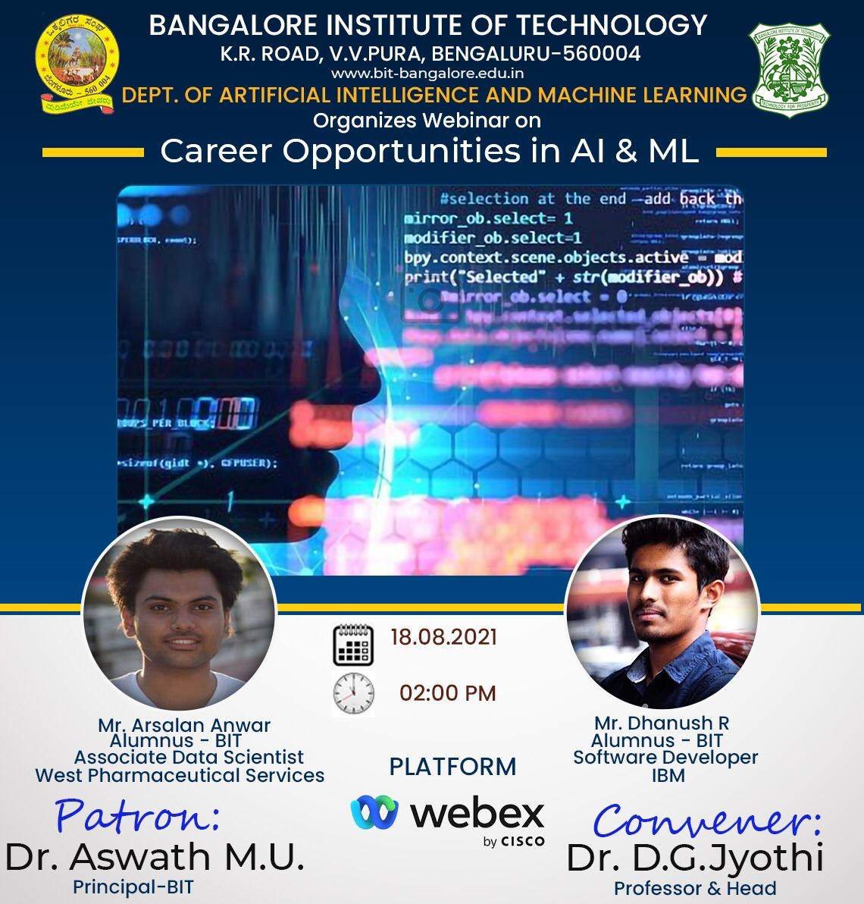
Career opportunities in AI & ML
2:00 PM ONWARDS
18 AUGUST 2021

Slide 2


About us
ARSALAN ANWAR
I am an Associate Data Scientist at West Pharmaceutical Services. I am deeply passionate about Data Science and Artificial Intelligence. I have working knowledge in Machine Learning, Deep Learning, Robotics and Reinforcement Learning. I also build scalable web applications which are used to integrate with the ML models developed!
DHANUSH R
I am a Software Developer at IBM. I am a Data Science and Artificial Intelligence enthusiast aiming to solve complex problems. I have good understanding in Machine Learning, Deep Learning and Natural Language Processing.

Slide 3
AGENDA
What is AI & ML?
Why is AI & ML important?
What are the Career Opportunities
Bonus: How to build your profile
Who is using these technologies?
What do you need to focus on?

Slide 4

What is AI & ml?

Slide 5


Slide 6

Why is AI & ml important?

Slide 7
Benefits of AI & ML
Artificial intelligence will transform the global economy, and AI jobs are in high demand.
The ability to make sense of huge amount of data and interpret it, adds a lot of business value.
AI careers are future-proof, meaning they are likely to survive well into the future.

Slide 8
The Future Of Ai
The AI market will grow to a $190 billion industry by 2025
Global spending on cognitive and AI systems will reach $57.6 billion in 2021
It is predicted that 60% of digital transformation initiatives will use AI services by 2022.
It is forecasted that 90% of new enterprise apps will use AI by 2025.

Slide 9

Who is using these technologies?

Slide 10
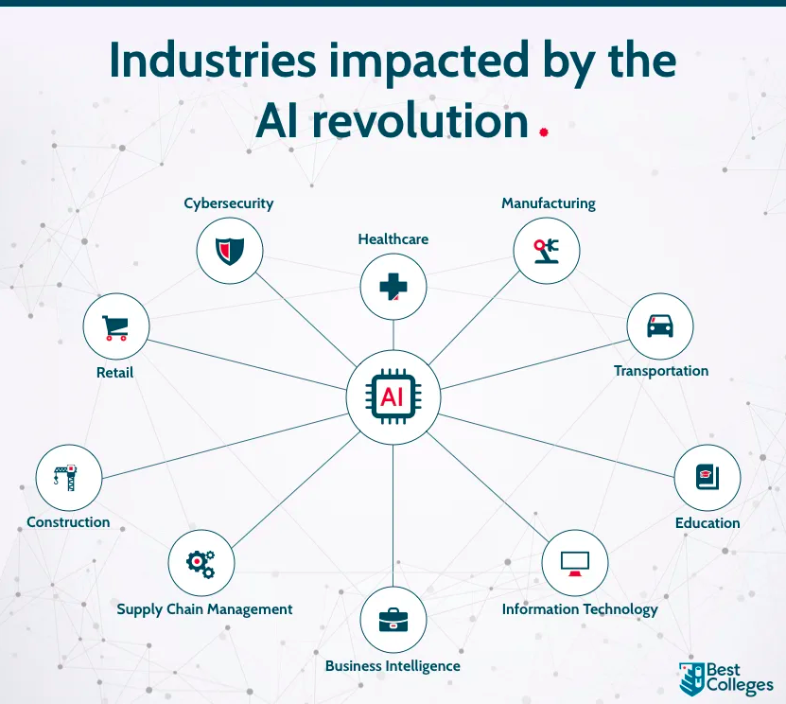
Industries where AI & ml is used
Social Media
Healthcare & Fitness
Retail
Sales and Marketing
Financial Institutions
Education
Manufacturing
Transportation & Conveyance
Personal Security

Slide 11

Career opportunities

Slide 12
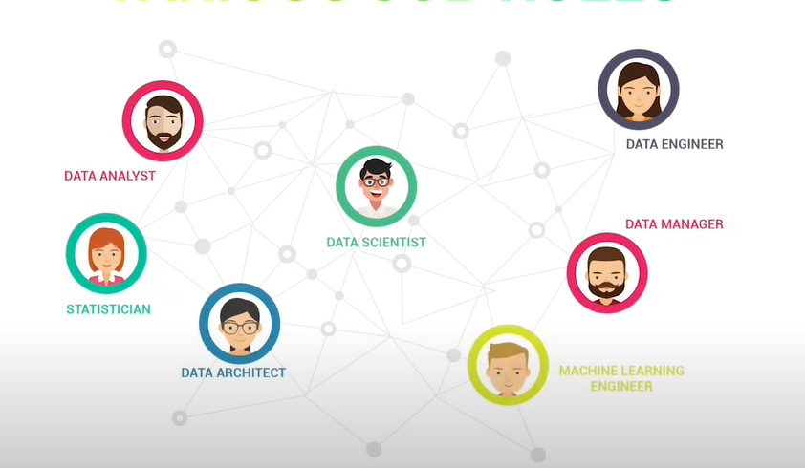
Popular job roles in AI
ML Research Scientist
Data Engineer
Data Scientist
ML Engineer
Data Analyst
Robotics Engineer
Computer Vision Engineer
NLP Engineer

Slide 13
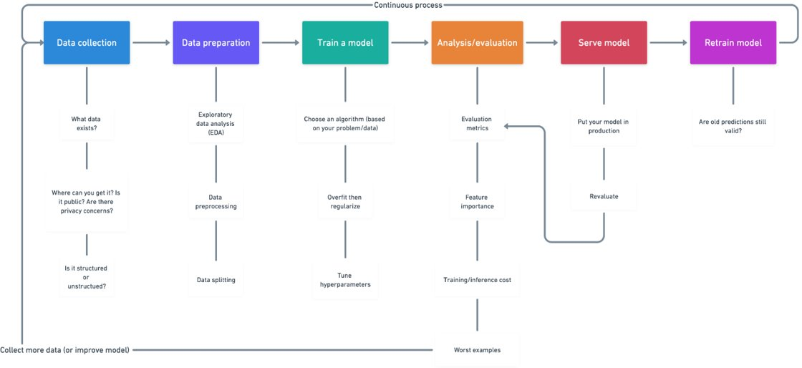
Machine learning process
To understand various job roles, it is important to know the machine learning process.

Slide 14
Before moving forward, how many of you know which Data Science role you want to get into?

Slide 15
Data engineer
Data engineers are vital members of any enterprise data analytics team as we need data for any process that we do!
Data engineers are responsible for managing, optimizing, overseeing and monitoring data retrieval, storage and distribution throughout the organization by building massive reservoirs for big data.
They develop, construct, test and maintain architectures such as databases and large-scale data processing systems.
Once continuous pipelines are installed to — and from — these huge “pools” of filtered information, data scientists and the rest of the team can pull relevant data sets for their analyses.
Subjects: Data Mining, Big Data Analytics, DBMS.
Skills: Data Warehousing, Big Data Analytics, ETL, Hadoop, Scala, DBMS etc.

Slide 16
Data Analyst
A data analyst is someone who scrutinizes information using data analysis tools.
Data Analysts look for patterns in the data, summarize it and present the data in a way which is understandable by the clients and the stakeholders.
The meaningful results they pull from the raw data help their employers or clients make important decisions by identifying various facts and trends
Subjects: Mathematics, BDA, DBMS, programming(Python).
Skills: Programming languages, such as SQL, Oracle and Python, analytic skills, interpretability skills, visualization skills (Tableau, Power BI)

Slide 17
Data Scientist
Data scientists have a wide variety of skill sets that can leverage data and information to help organizations to make better strategic decisions.
They get exciting opportunities to work and experiment with data to produce suitable solutions for the businesses.
Data scientists are big data wranglers. They take an enormous mass of messy data points (unstructured and structured) and use their formidable skills in math, statistics and programming to clean, massage and organize them.
Then they apply all their analytic powers — industry knowledge, contextual understanding, skepticism of existing assumptions — to uncover hidden solutions to business challenges.
Subjects: Mathematics, Programming (Python, R, SQL), AI, ML, Data Structures, DBMS
Skills: Programming, Data Visualization, ML, Kubernetes and Docker

Slide 18
ML Engineer
A machine learning engineer is a person who has both software programming skills as well as Data Science knowledge.
ML Engineer is like a bridge between a Data Scientist and a Software Engineer .
He/ She focuses on researching, building and designing machine learning processes.
One must have a strong hand on software skills, have the knowledge of how to apply predictive models and utilize natural language processing while working with huge datasets.
Subjects: ML, Statistics and probability(advanced), Algorithms and data structures, OS, programming(OOP).
Skills: Mathematics(Statistics and probability), ML, DL, Kubernetes and containers

Slide 19
ML Research Scientist
An ML Research Scientist is responsible for exploring and designing custom algorithms and architectures
They try to design and develop algorithms that cater to specific kind of problems where other existing algorithms might not work as intended
Also, to be a research scientist, one should have a strong knowledge of different AI disciplines.
Subjects: Mathematics, OS, Linux, CO, ML, DL, Programming Language(Python, R)
Skills: Distributed Systems, Parallel Computing, ML, DL, Domain Knowledge. Problem – solving.

Slide 20
Now, how many of you know which Data Science role you want to get into?

Slide 21

What to focus on?

Slide 22
What Subjects to focus on?
MATHEMATICS​
COMPUTER SCIENCE​
AI CORE SUBJECTS​
Linear Algebra
Differential and Integral Calculus
Matrices and Linear Transformations
Discrete Mathematical Structures
Probability Theory
Bayesian Networking
Data Structures and Applications
Software Engineering
Object Oriented Concepts
Design and Analysis of Algorithm.
Operating systems
DBMS
Unix/Linux Programming
Machine Learning and Deep Learning
Computer Vision and Image Analysis
Natural Language Processing
Data Mining and Data Warehousing
Robotics and Reinforcement Learning
AI Representation and Problem-Solving

Slide 23
What Tech Stack To focus ON?
Programming Languages: Python (Pandas, Numpy), one OOPS Language like Java, C#/C++, SQL, R
Machine Learning Frameworks: TensorFlow, Sci-kitLearn, PyTorch, Keras
Cloud Platforms: AWS, Azure, GCP
Big Data Tools: Spark, HBase, Kafka, HDFS, Hadoop, MapReduce
Natural Language Processing Tools: spaCy, NLTK
Visualization Tools: Power BI, Tableau

Slide 24

Bonus: How to build Profile?

Slide 25
Bonus section: How to build your profile
KNOWLEDGE
IMPLEMENTATION
VISIBILITY

Slide 26
Bonus section: How to build your profile
KNOWLEDGE
IMPLEMENTATION
VISIBILITY
Course Material
Online Certification Courses: Coursera, Udemy, Microsoft, AWS
Youtube, Medium, etc.
Mini/Side Projects
Final Year Project
Build your GitHub profile
Solve problems on Kaggle
Build profile on Hackerrank, Hackerearth, etc.
Write blogs/articles on Medium, Wordpress, etc.
Hackathons/ Tech Events/ Fests
Publish research papers

Slide 27
Contact us:
Arsalan Anwar
Mail: dhanushrreddy6@gmail.com
LinkedIn: https://www.linkedin.com/in/dhanushrr6/
Mail: arsalan.anwar.7777@gmail.com
LinkedIn: https://www.linkedin.com/in/arsalananwar1998/
Medium: https://thearsalion.medium.com/
Dhanush R
Please feel free to shoot us a message in case of any queries!

Slide 28
Thank you!

